Slide 1



INTELLIGENT
LOW-POWER ECG
NOISE SUPPRESSION
USING EDGE AI
GPX10 Implementation + ASIC-Oriented Hardware Architecture
Low Power . Low Latency . Hardware Efficiency
From BMS College of Engineering,
Chiranth A D Utkarsha
Deepak SR Dhanush G
Referred and Guided By,
Dr. Archana H R

Slide 2


INTELLIGENT LOW-POWER ECG NOISE SUPPRESSION USING EDGE AI
OBJECTIVE:
Develop an ECG-specific, low-power signal-processing architecture combining AI-based noise identification with hardware-efficient digital filtering for continuous on-device ECG processing.
Key Goals:
  Low Power
  Low Latency
  On-Device Intelligence
  Hardware Efficiency
  Adaptive Noise Suppression
  Sensor-Fusion Potential
ECG
Noisy Signal
Edge AI Analysis
Noise Identification
Intelligent Filtering
Clean ECG

Slide 3
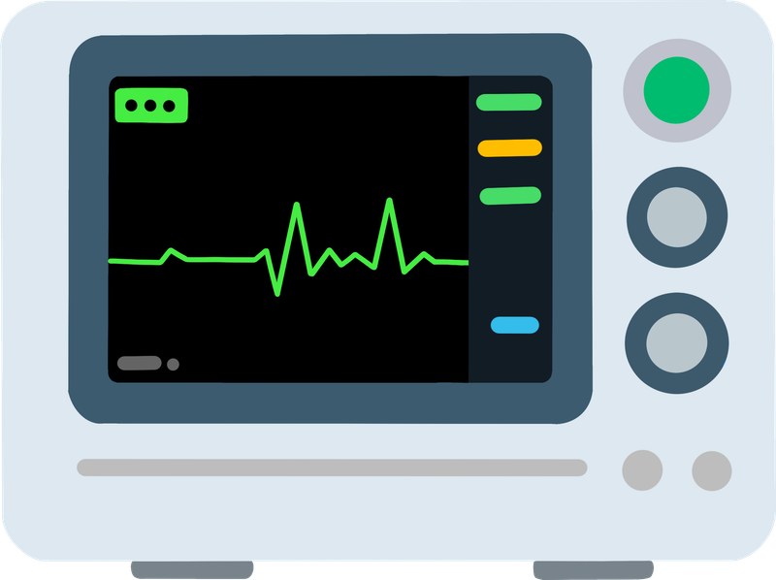
INTELLIGENT LOW-POWER ECG NOISE SUPPRESSION USING EDGE AI
PROBLEM DEFINITION & RESEARCH GAP
The challenge is not simply ECG acquisition — it is performing continuous, adaptive signal processing under strict power and latency constraints.
There is a need for a low-power architecture that can intelligently identify ECG noise conditions and dynamically select efficient filtering, while minimizing computation, latency and hardware resources.

Slide 4








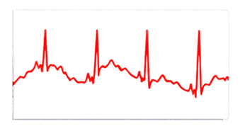
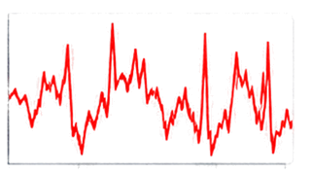
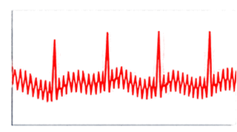
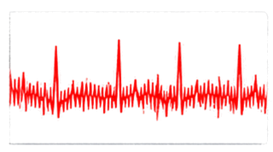
















INTELLIGENT LOW-POWER ECG NOISE SUPPRESSION USING EDGE AI
COMMON ECG NOISES & CORRESPONDING FILTERS
1
Baseline Wander
2
Power-Line Interference
High-Frequency / EMG Noise
4
Motion Artifact
03
3
Low-frequency drift
50 Hz periodic noise
Muscle activity
Irregular and non-stationary noise
4
Amplitude (mv)
Amplitude (mv)
Amplitude (mv)
Amplitude (mv)
Time (s)
Time (s)
Time (s)
Time (s)
Source
Source
Source
Source
Respiration, body movement, electrode impedance changes
Electrical coupling from mains supply (50 Hz)
Muscle activity / EMG interference
Electrode movement, poor skin contact, body movement
Use
Use
Use
Use
High-Pass Filter (HPF)
50 Hz Notch Filter
Low-Pass Filter (LPF)
Adaptive / Reconfigurable Filter

Slide 5
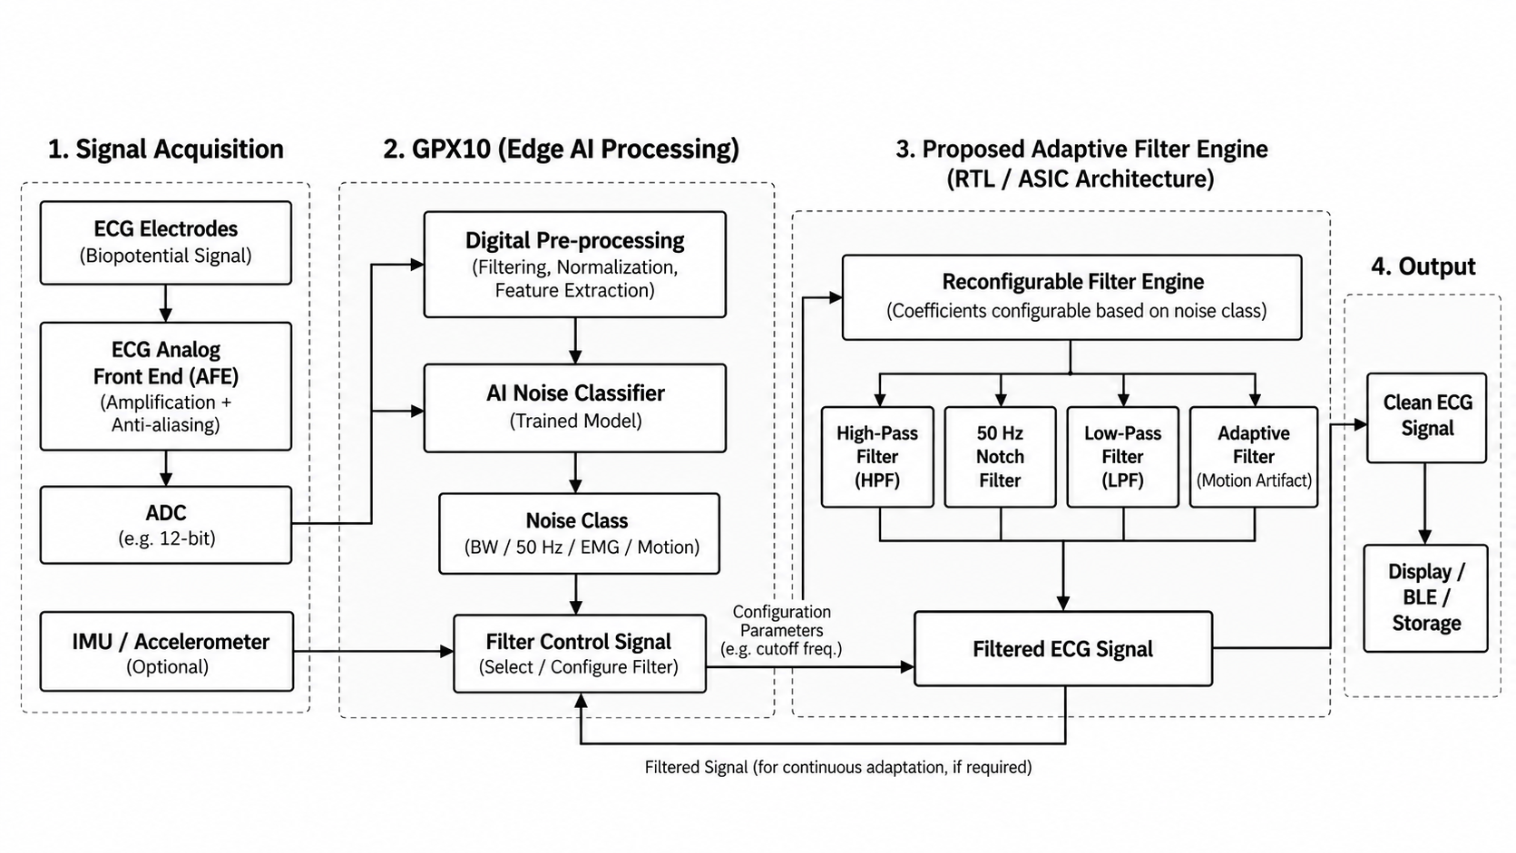
INTELLIGENT LOW-POWER ECG NOISE SUPPRESSION USING EDGE AI
BLOCK DIAGRAM

Slide 6
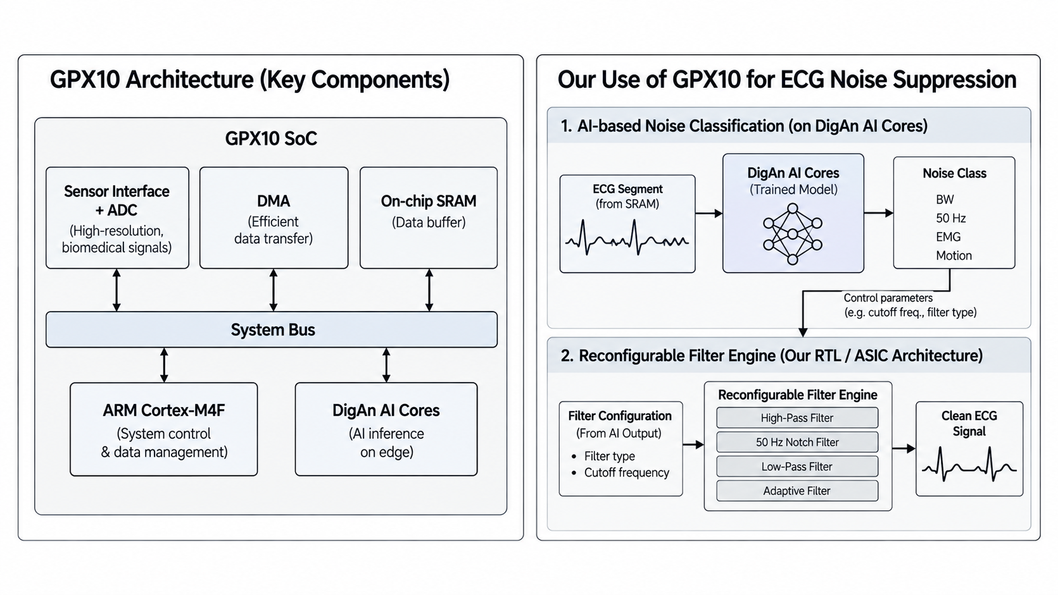
INTELLIGENT LOW-POWER ECG NOISE SUPPRESSION USING EDGE AI

Slide 7
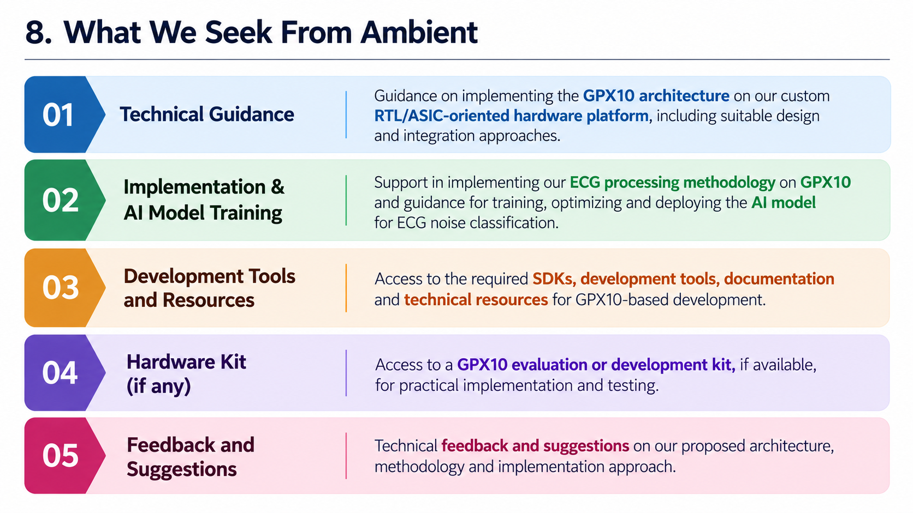
INTELLIGENT LOW-POWER ECG NOISE SUPPRESSION USING EDGE AI
WHAT WE SEEK?

Slide 8

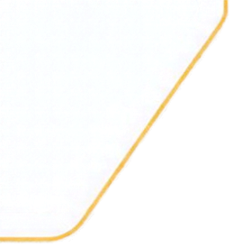




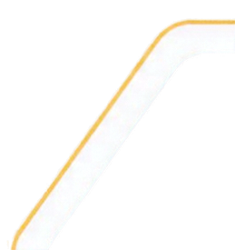


THANK YOU
We look forward to turning this proposed solution into a reliable and intelligent ECG monitoring system.

